Slide 1
Fraud Detection Model
CAPSTONE PROJECT
Presented By:
Dipan Basak
Institute of Engineering and Management
CSE

Slide 2
OUTLINE
Problem Statement (Should not include solution)
Proposed System/Solution
System Development Approach (Technology Used)
Algorithm & Deployment
Result
Conclusion
Future Scope
References

Slide 3
Problem Statement
Fraudulent transactions result in significant financial losses and increased risk for businesses. Current methods for detecting fraud are often inadequate due to the complexity and volume of transactions. There is a need for an advanced, efficient, and accurate system to predict and mitigate fraudulent activities in real-time.

Slide 4
Proposed Solution
The proposed system utilises IBM’s Auto AI technology within Watson Studio to automate the creation of a fraud detection model. This system will:
Automate data pre-processing, model selection, and hyperparameter tuning
Quickly build, evaluate, and deploy predictive models
Provide a scalable and adaptable solution for various predictive tasks

Slide 5
System Approach
IBM Watson Studio: Collaborative environment for data analysis and model building
IBM Auto AI: Automates the creation of machine learning models
IBM Cloud Object Storage: Secure and efficient data storage

Slide 6
Algorithm & Deployment
Auto AI uses multiple machine learning algorithms, including decision trees, random forests, and gradient-boosting machines.
Data Input: Historical transaction data and additional relevant factors.
Training Process: Auto AI trains models using historical data with techniques like cross-validation and hyperparameter tuning.
Prediction Process: The trained algorithm predicts future fraudulent transactions, using real-time data inputs.
Deployment: The best model is selected and deployed to generate predictions via REST API calls.

Slide 7
Result
The Auto AI-generated model demonstrated high accuracy in predicting fraudulent transactions, effectively reducing financial losses and mitigating risks. The automated process saved significant time and effort compared to manual model building, enabling faster decision-making.

Slide 8
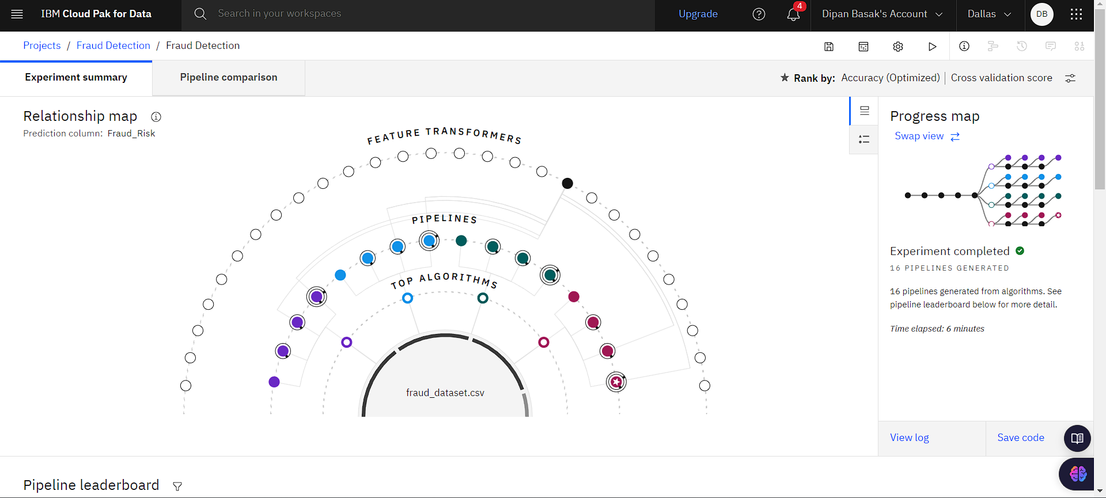
Screen Shots

Slide 9
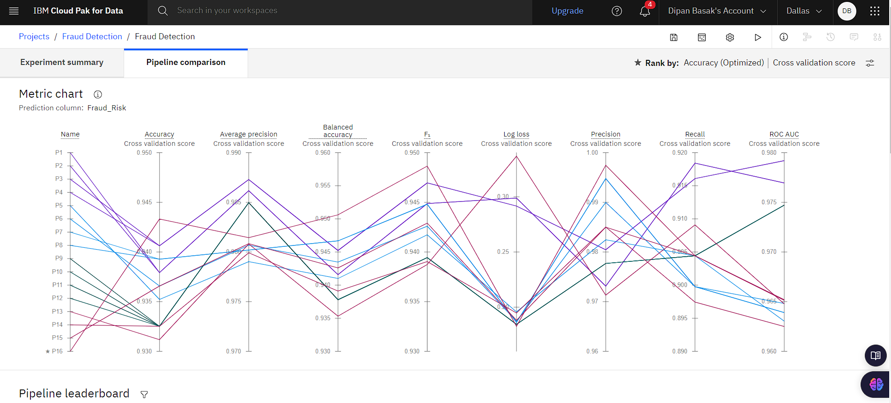

Slide 10
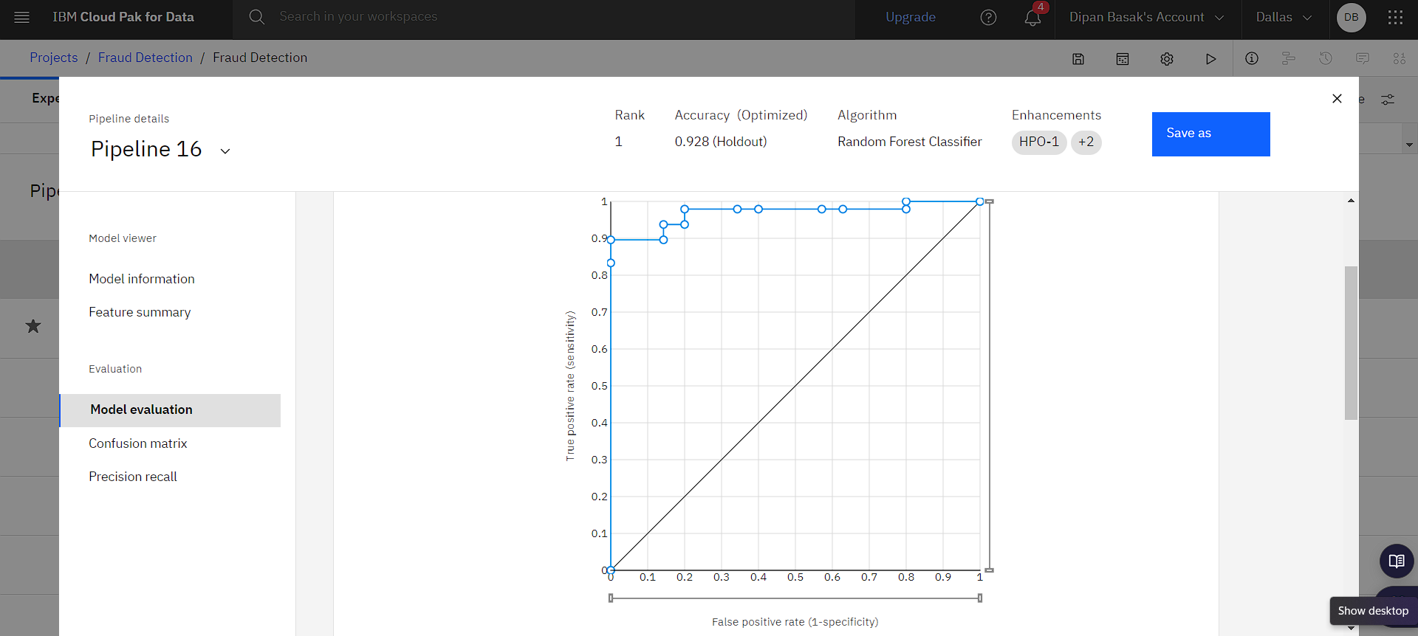

Slide 11
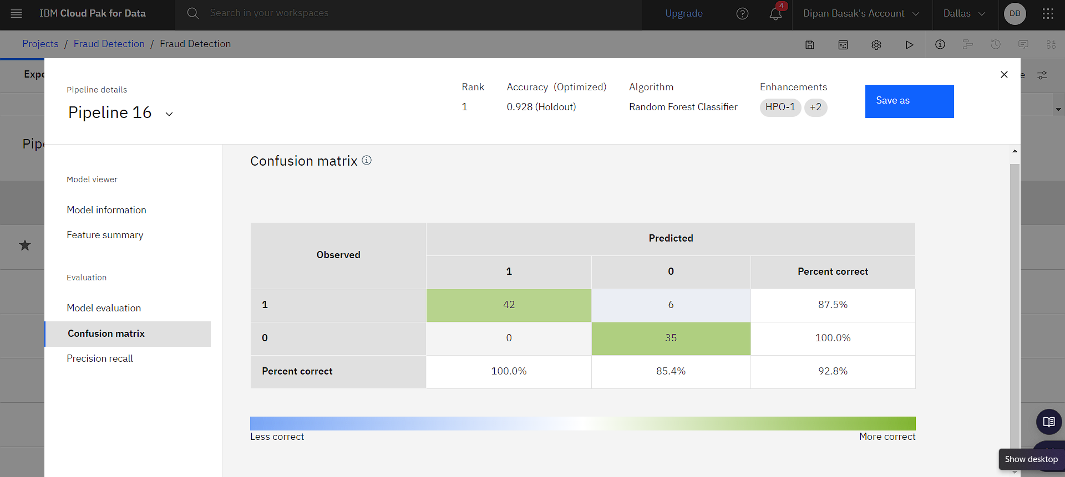

Slide 12
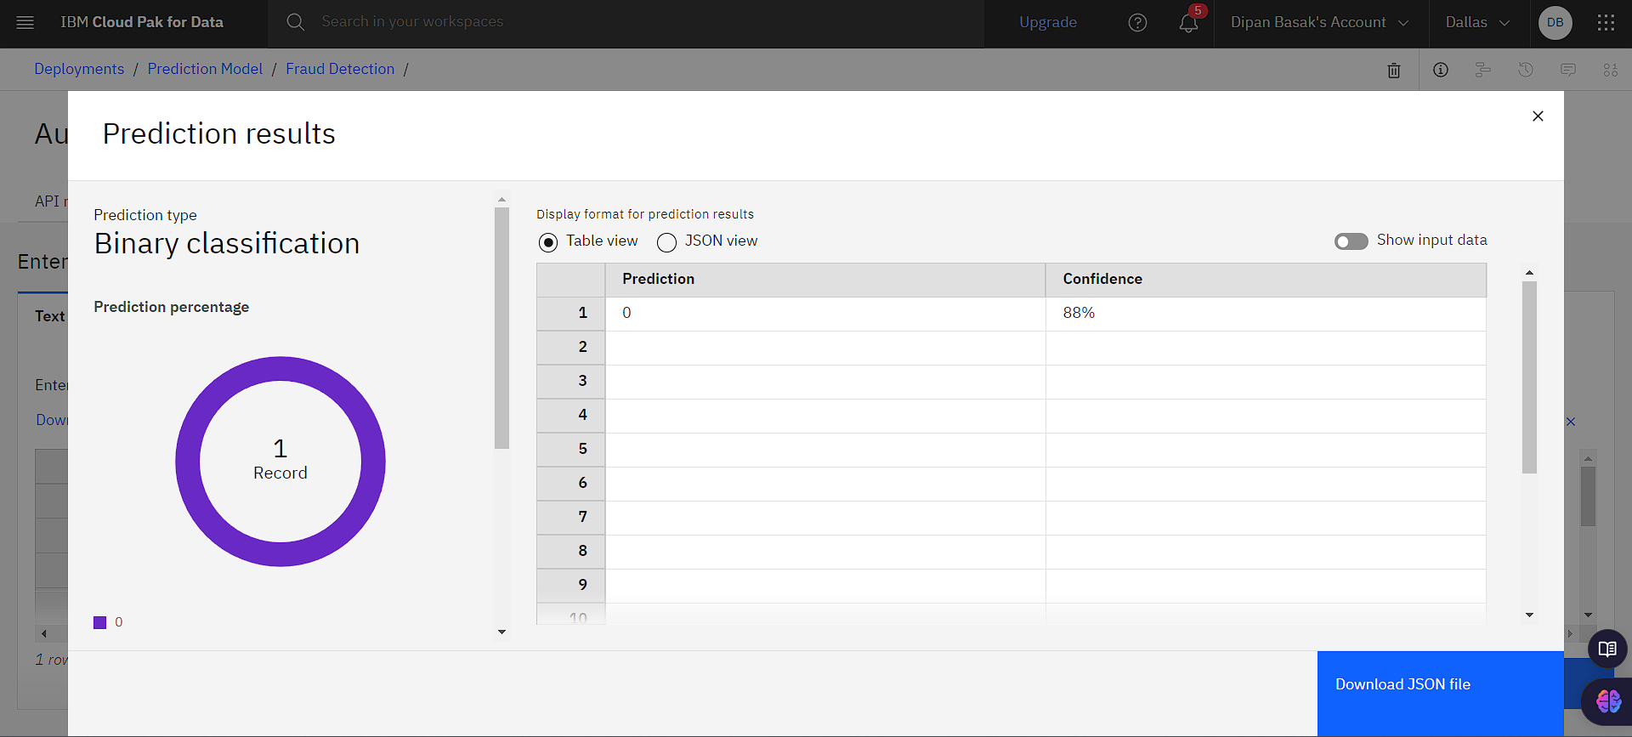

Slide 13
Conclusion
Using IBM’s Auto AI within Watson Studio provides an efficient and accurate solution for fraud detection. This automation enhances productivity and ensures high-quality results, making it a valuable tool for businesses to mitigate fraud and other risks.

Slide 14
Future scope
Enhanced Algorithms: Integrate advanced techniques like deep learning.
Real-time Processing: Implement real-time data processing for immediate detection.
Broader Applications: Adapt the system for tasks like customer behavior analysis and inventory management.
Scalability: Expand to handle larger datasets and more complex scenarios.

Slide 15
References
IBM Watson Studio documentation
IBM Auto AI overview and user guides
Academic papers on machine learning for fraud detection
GitHub ripos for data collection

Slide 16
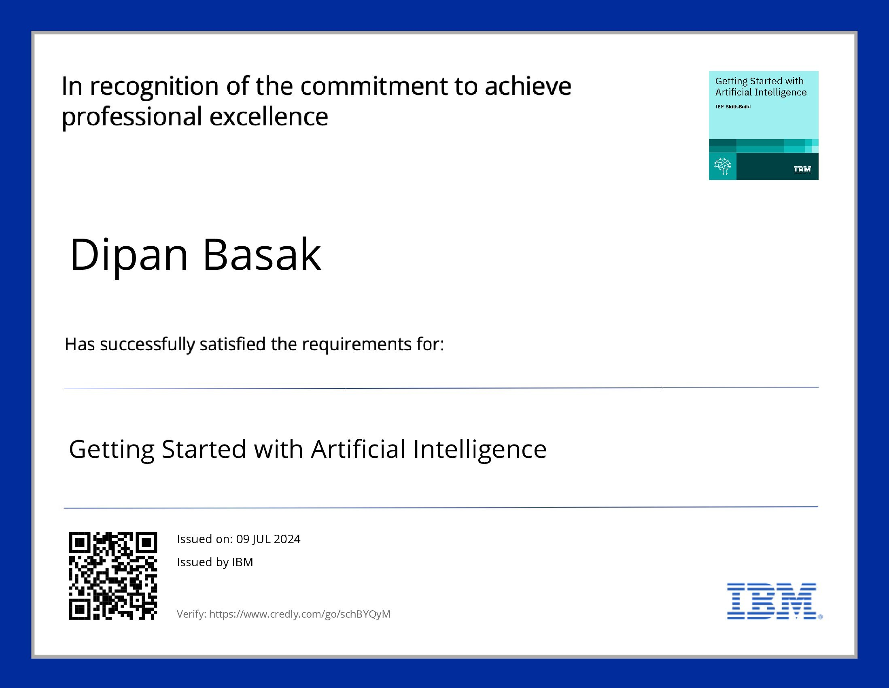
course certificate 1

Slide 17
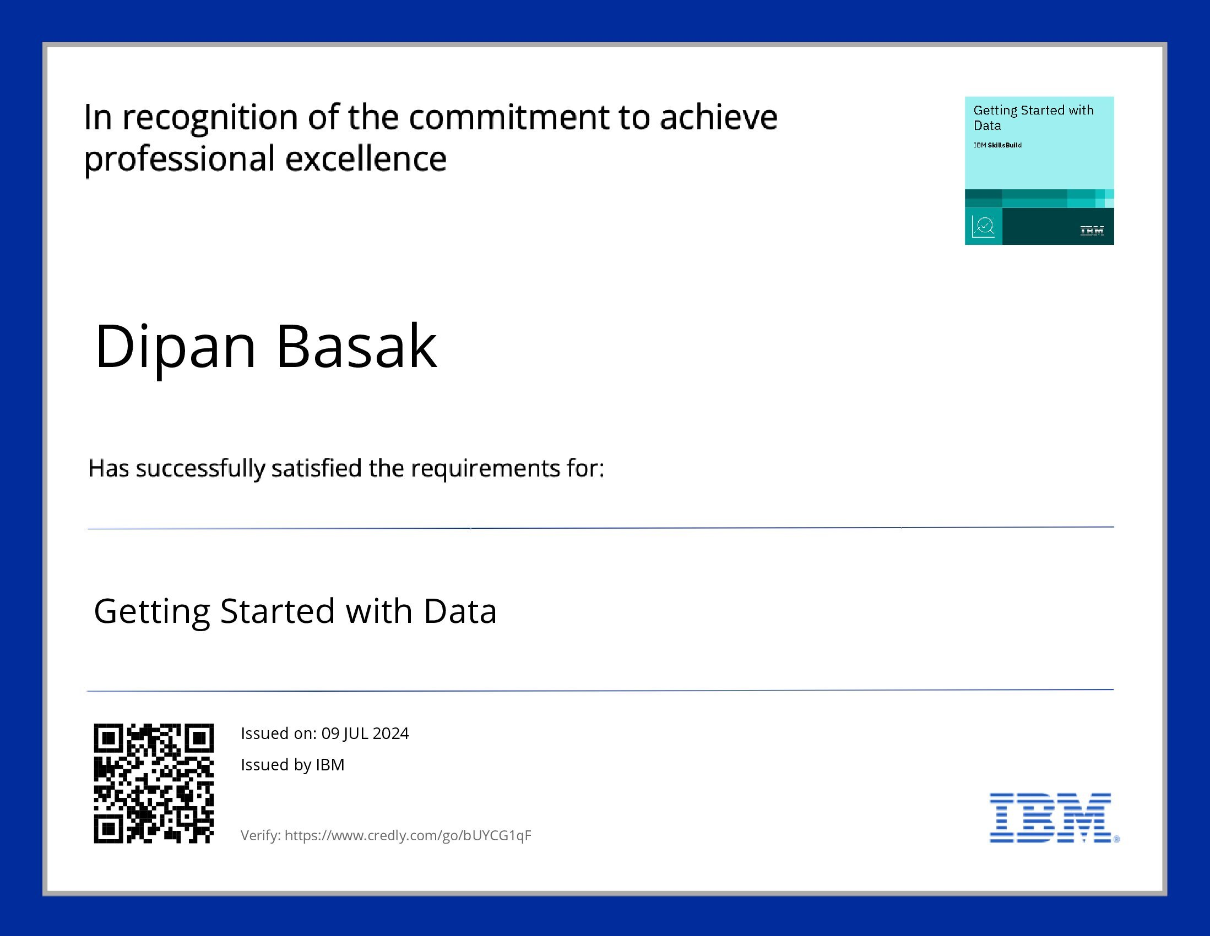
course certificate 2

Slide 18
THANK YOU

